Slide 1
Transformers Booths Catalog Price List
Email: sales@transformers-me.com
Mobile: +201110999646 - +201110999648
WhatsApp:+201110999646 - +201110999648
When ordering please send booth code and dimensions

Slide 2
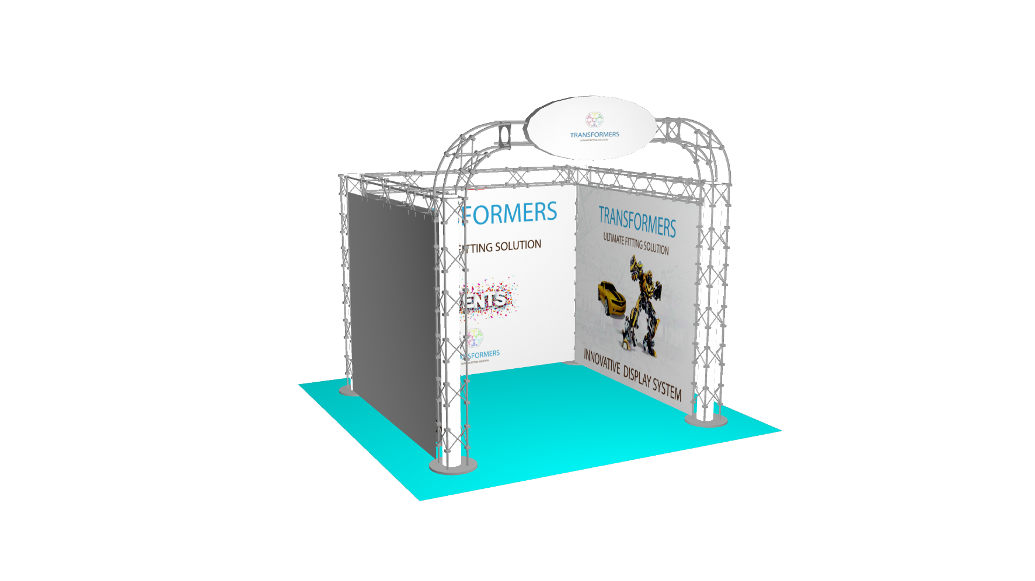
U Shape Booth Code (A)
WEDTH | DEPTH | Price
3 M | 3 M | 6000 LE
4 M | 3 M | 6500 LE
5 M | 3 M | 7500 LE
6 M | 3 M | 9000 LE
9 M | 3 M | 13000 LE
Specs:
1- U SHAPE BOOTH / Podium Included
2- Wooden Sign(70X30 CM\ vinyl print)
3- 3 Spotlights for every 9 M2
Extra Spotlight (75 LE)
4- Single Print
Extra banners (80 EGP\M2 )for double print

Slide 4
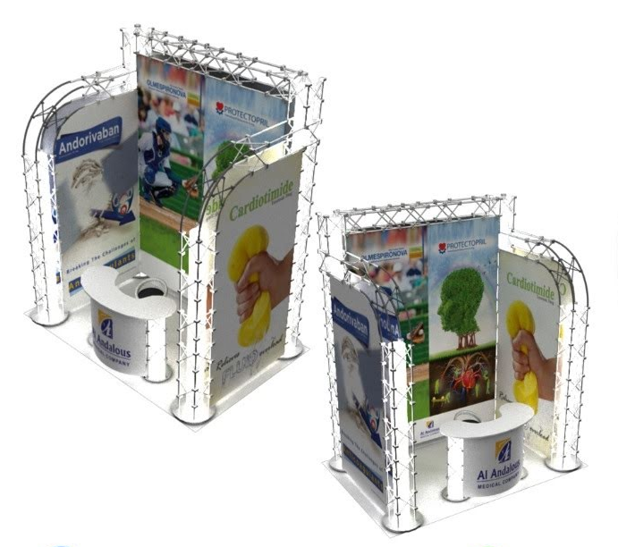
U Shape Elegant booth Code (B)
WEDTH | DEPTH | Price
3 M | 3 M | 4500 LE
4 M | 3 M | 6000 LE
5 M | 3 M | 7500 LE
6 M | 3 M | 8500 LE
9 M | 3 M | 11500 LE
Specs:
1- U SHAPE BOOTH / Podium Included
2- 3 Spotlights for every 9 M2
Extra Spotlight (75 LE)
3- Single Print
Extra banners (80 EGP\M2 )for double print

Slide 5
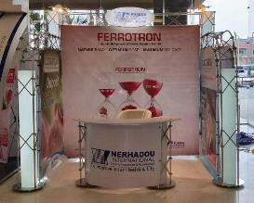
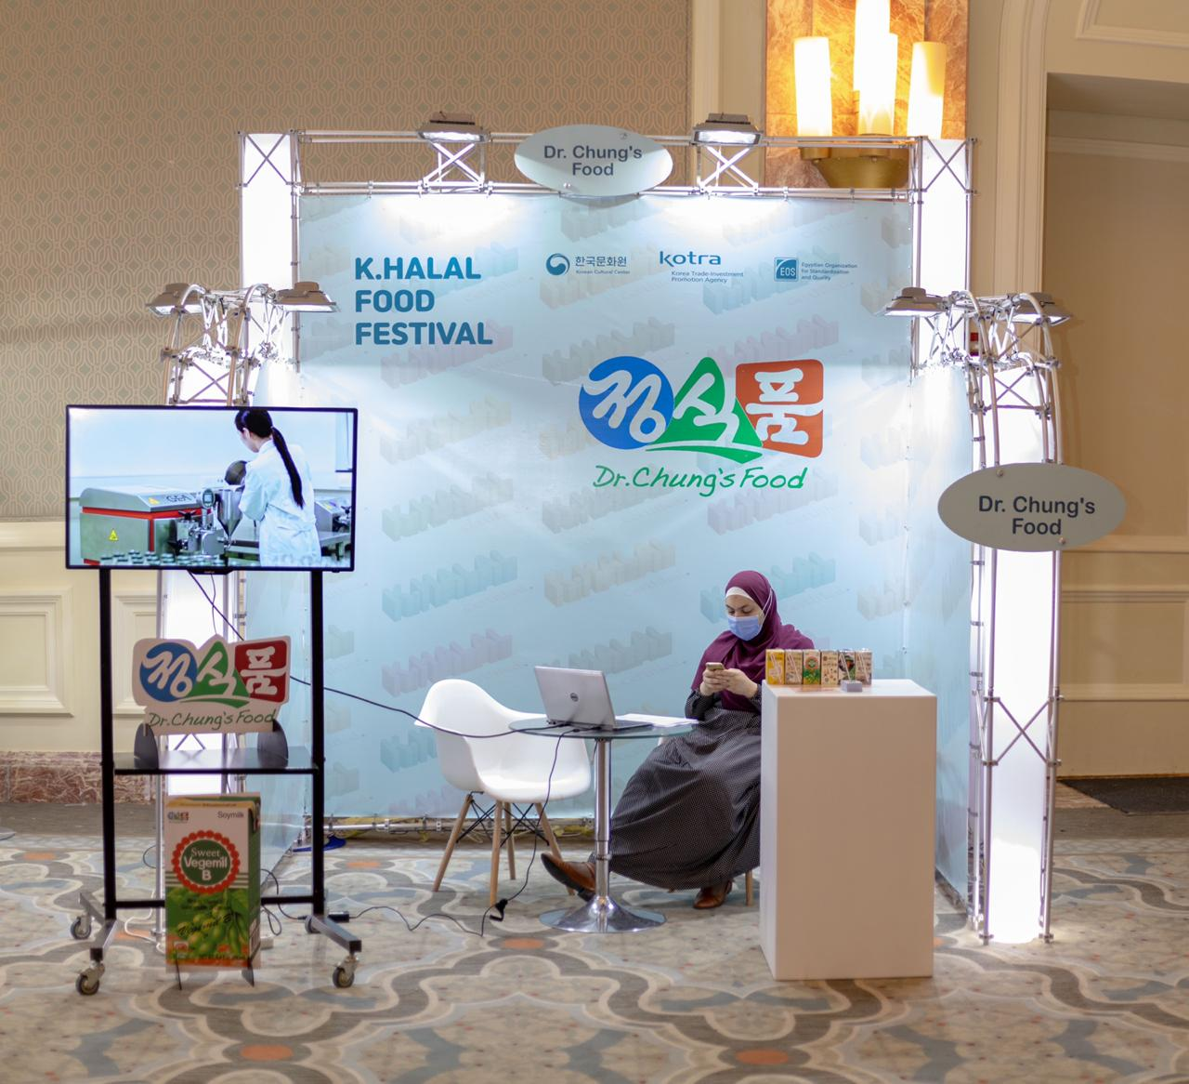

Slide 6
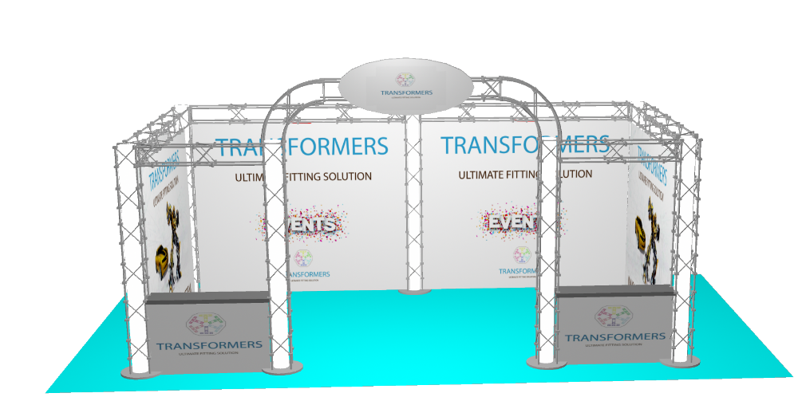
U Shape Luxury booth Code (C)
WEDTH | DEPTH | Price
6 M | 3 M | 10500 LE
6 M | 4 M | 13000 LE
6 M | 5 M | 16000 LE
Specs:
1- U SHAPE BOOTH / Podium Included
2- Wooden Sign(70X30 CM\ vinyl print) 2- 3
3- Spotlights for every 9 M2
Extra Spotlight (75 LE)
4- Single Print
Extra banners (80 EGP\M2 )for double print

Slide 7
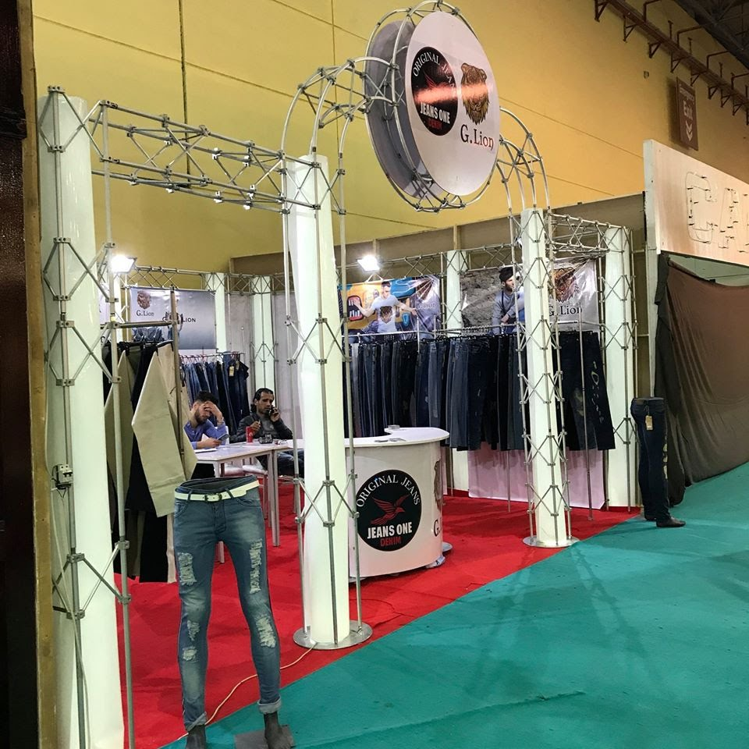
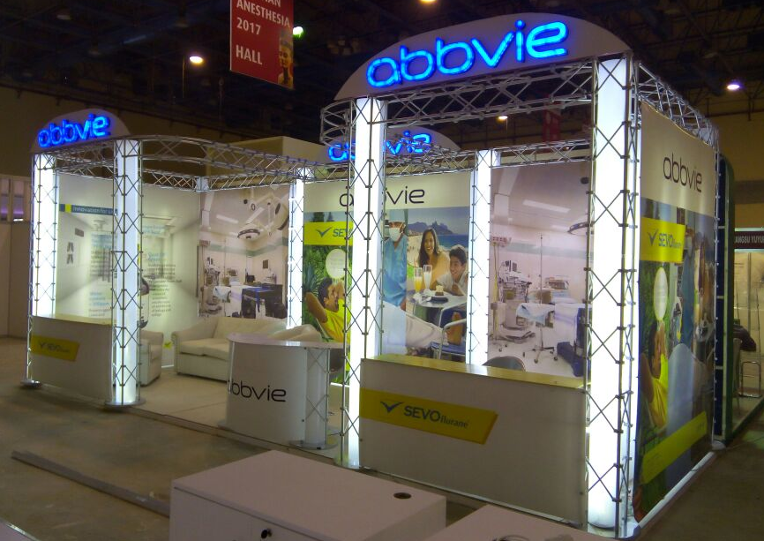
Specs: Any Lighted Logos or Signs extra cost

Slide 8
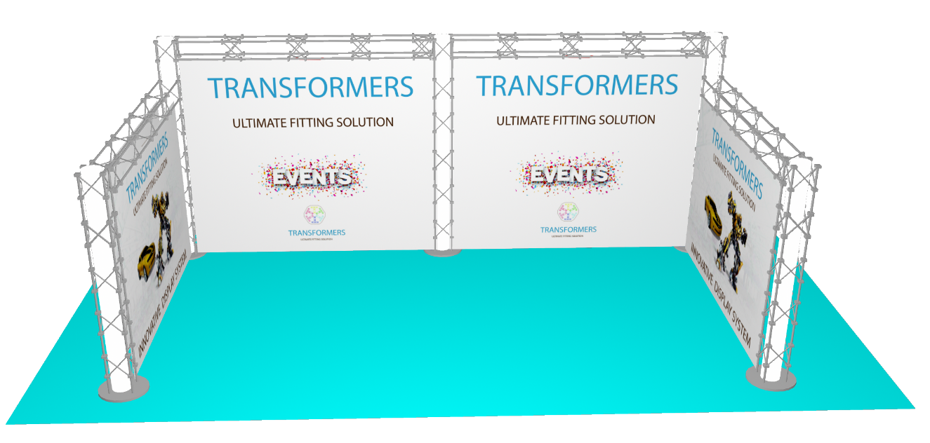
U Shape Simple booth Code (D)
WEDTH | DEPTH | Price
6 M | 3 M | 8000 LE
6 M | 4 M | 10500 LE
6 M | 5 M | 13000 LE
Specs:
1- U SHAPE BOOTH / Podium Included
2- 3 Spotlights for every 9 M2
Extra Spotlight (75 LE)
3- Single Print
Extra banners (80 EGP\M2 )for double print

Slide 9
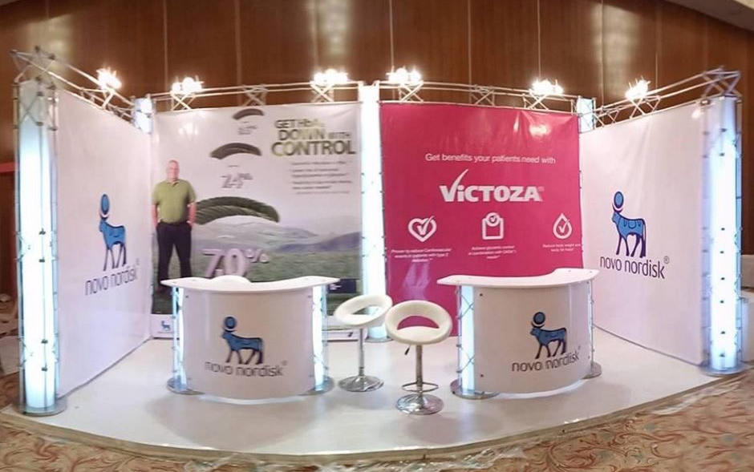
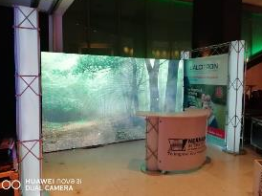

Slide 10
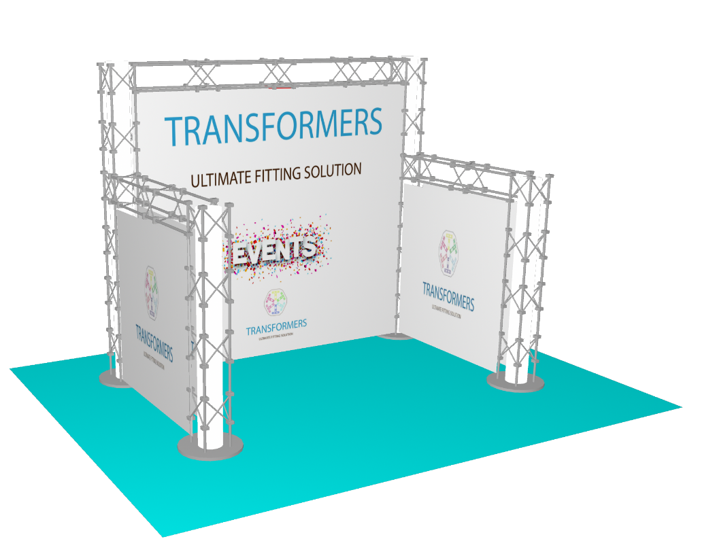
U Shape Economic booth code (E)
WEDTH | DEPTH | Price
3 M | 3 M | 4500 LE
4 M | 3 M | 5200 LE
5 M | 3 M | 6200 LE
6 M | 3 M | 7500 LE
7 M | 3 M | 10000 LE
185 cm
Specs:
1- U SHAPE BOOTH / Podium Included
2- 3 Spotlights for every 9 M2
Extra Spotlight (75 LE)
3- Single Print
Extra banners (80 EGP\M2 )for double print

Slide 11
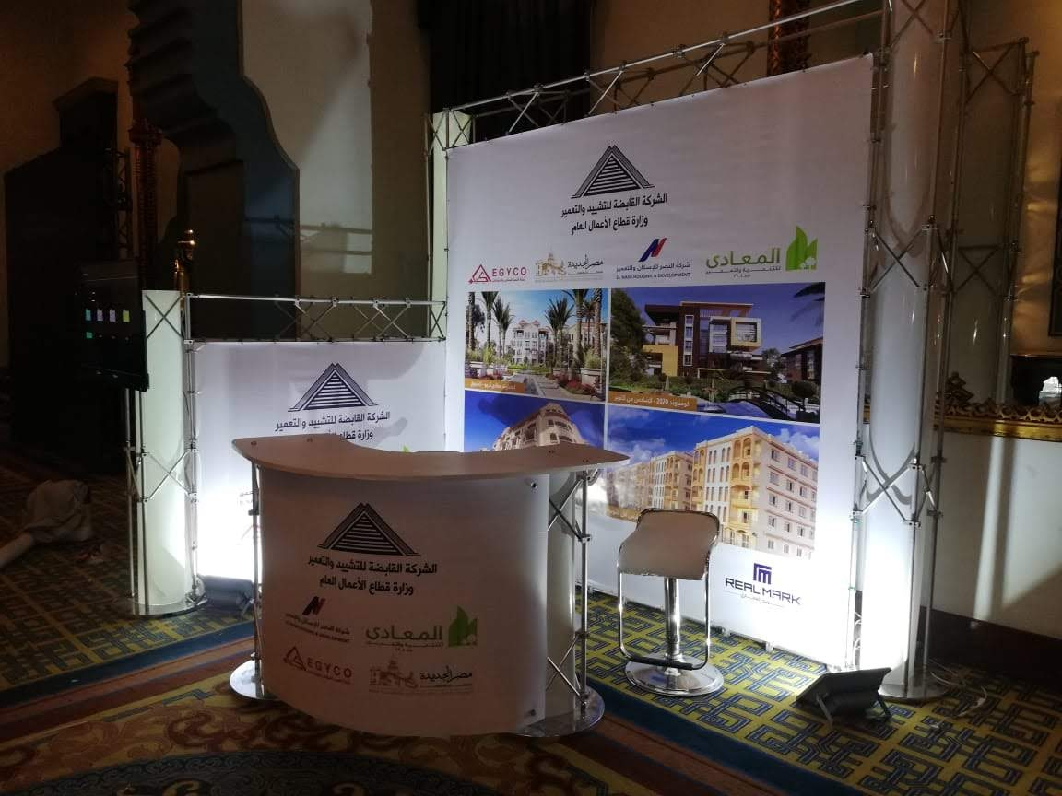
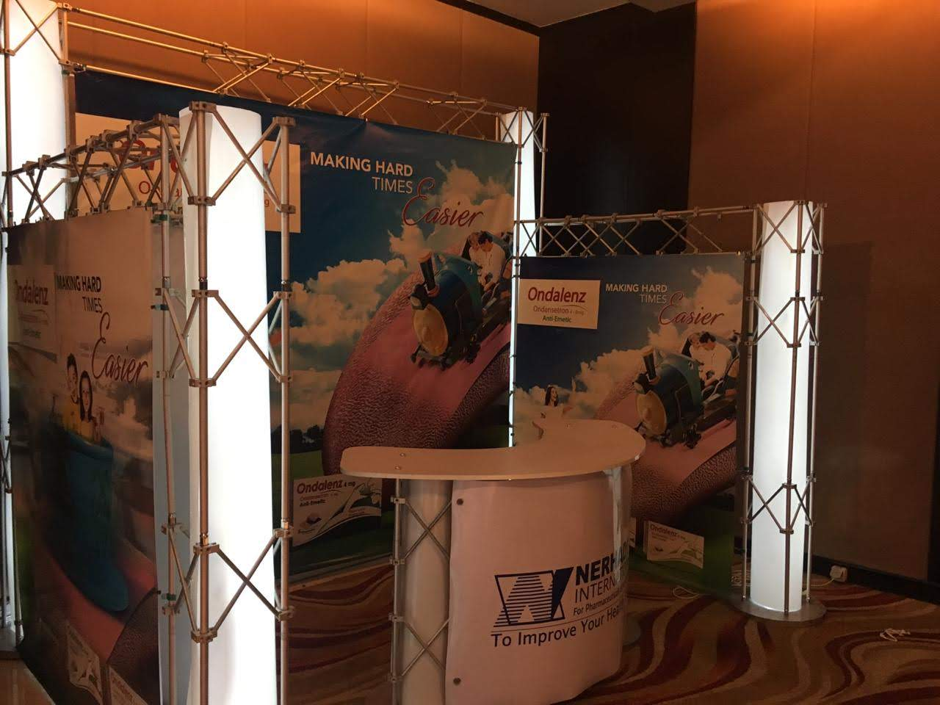

Slide 12
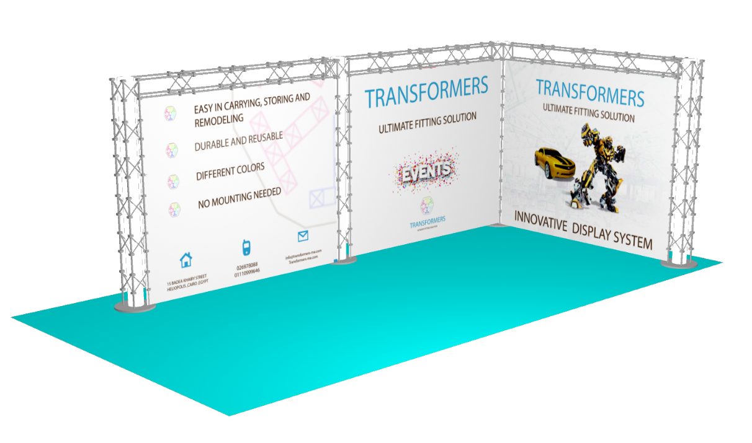
L Shape Simple booth Code (F)
WEDTH | DEPTH | Price
3 M | 3 M | 4500 LE
4 M | 3 M | 5200 LE
5 M | 3 M | 6200 LE
6 M | 3 M | 7500 LE
7 M | 3 M | 10000 LE
Specs:
1- L SHAPE BOOTH / Podium Included
2- 3 Spotlights for every 9 M2
Extra Spotlight (75 LE)
3- Single Print
Extra banners (80 EGP\M2 )for double print

Slide 13
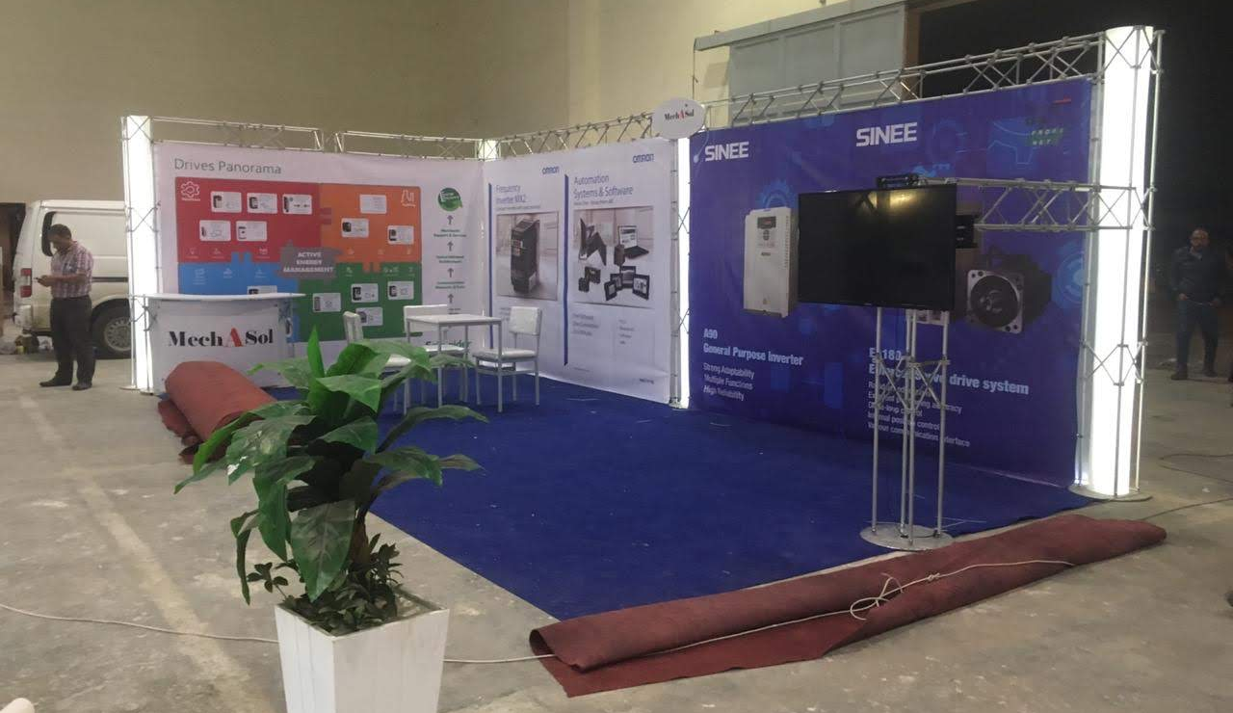
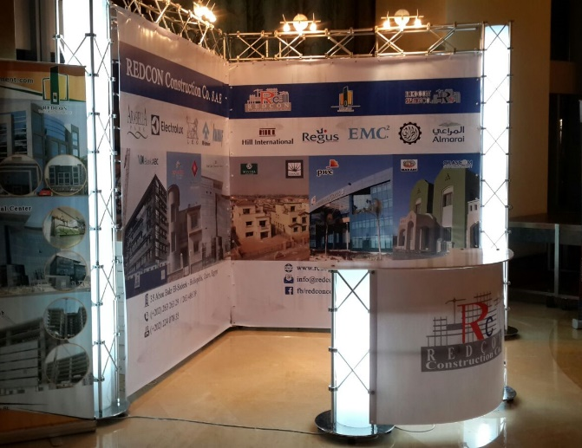

Slide 14
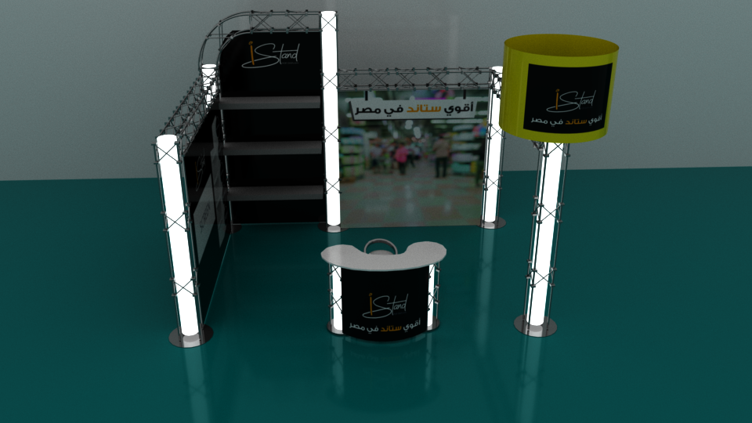
Elegant booth with Tower Code (G)
WEDTH | DEPTH | Price
4 M | 3 M | 6000 LE
5 M | 3 M | 7200 LE
6 M | 3 M | 8500 LE
7 M | 3 M | 10000 LE
8 M | 3 M | 12000 LE
Specs:
1- L SHAPE BOOTH / Podium Included / Tower
2- 3 Spotlights for every 9 M2
Extra Spotlight (75 LE)
3- Single Print
Extra banners (80 EGP\M2 )for double print

Slide 15
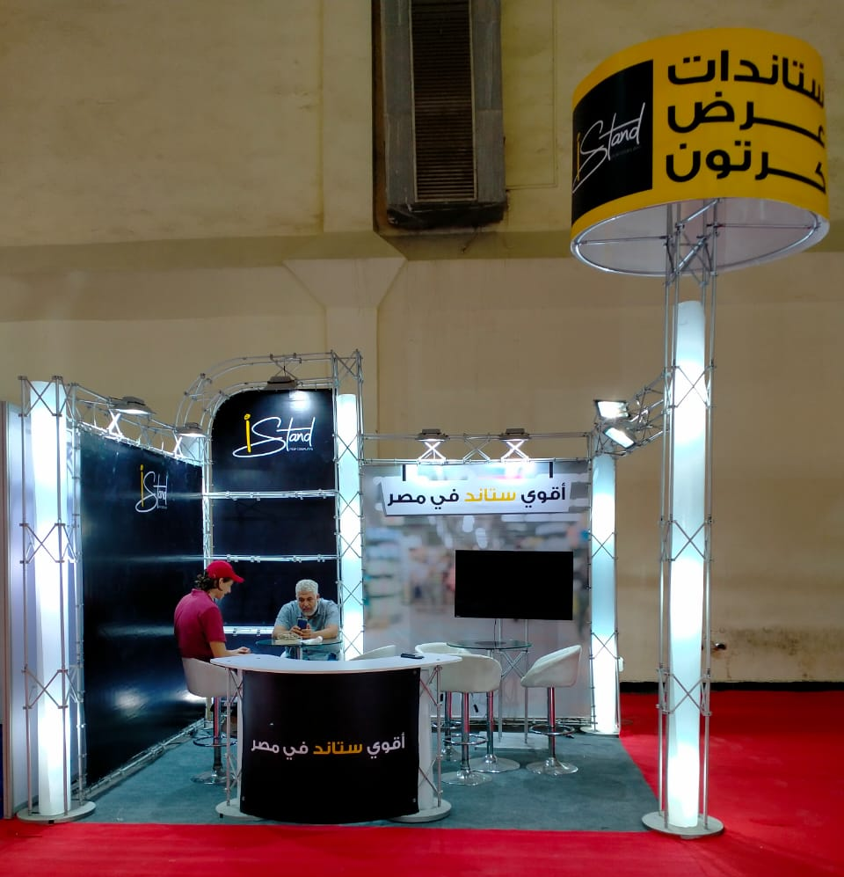
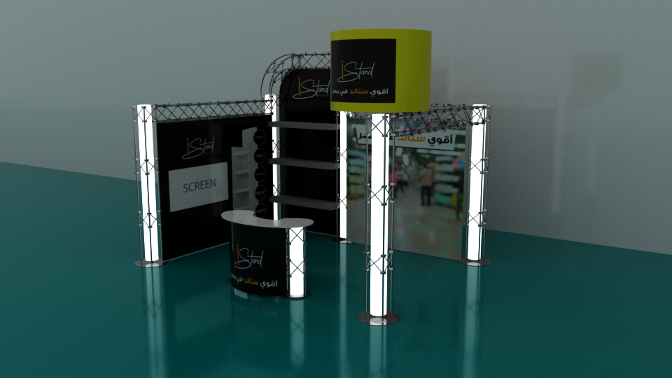

Slide 16
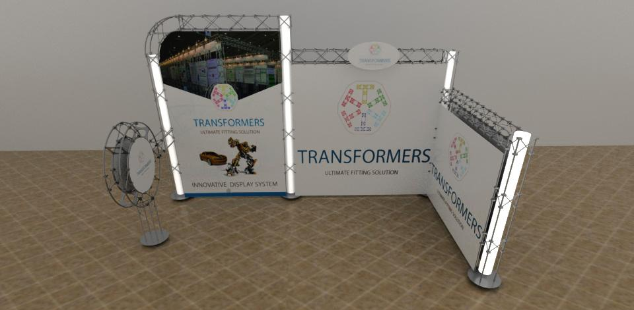
Elegant booth with ring Code (H)
WEDTH | DEPTH | Price
4 M | 3 M | 6000 LE
5 M | 3 M | 7200 LE
6 M | 3 M | 8500 LE
7 M | 3 M | 10000 LE
8 M | 3 M | 12000 LE
Specs:
1- L SHAPE BOOTH / Podium Included / Wooden Ring
2- Wooden Sign(70X30 CM\ vinyl print)
3- 3 Spotlights for every 9 M2
Extra Spotlight (75 LE)
4- Single Print
Extra banners (80 EGP\M2 )for double print

Slide 17
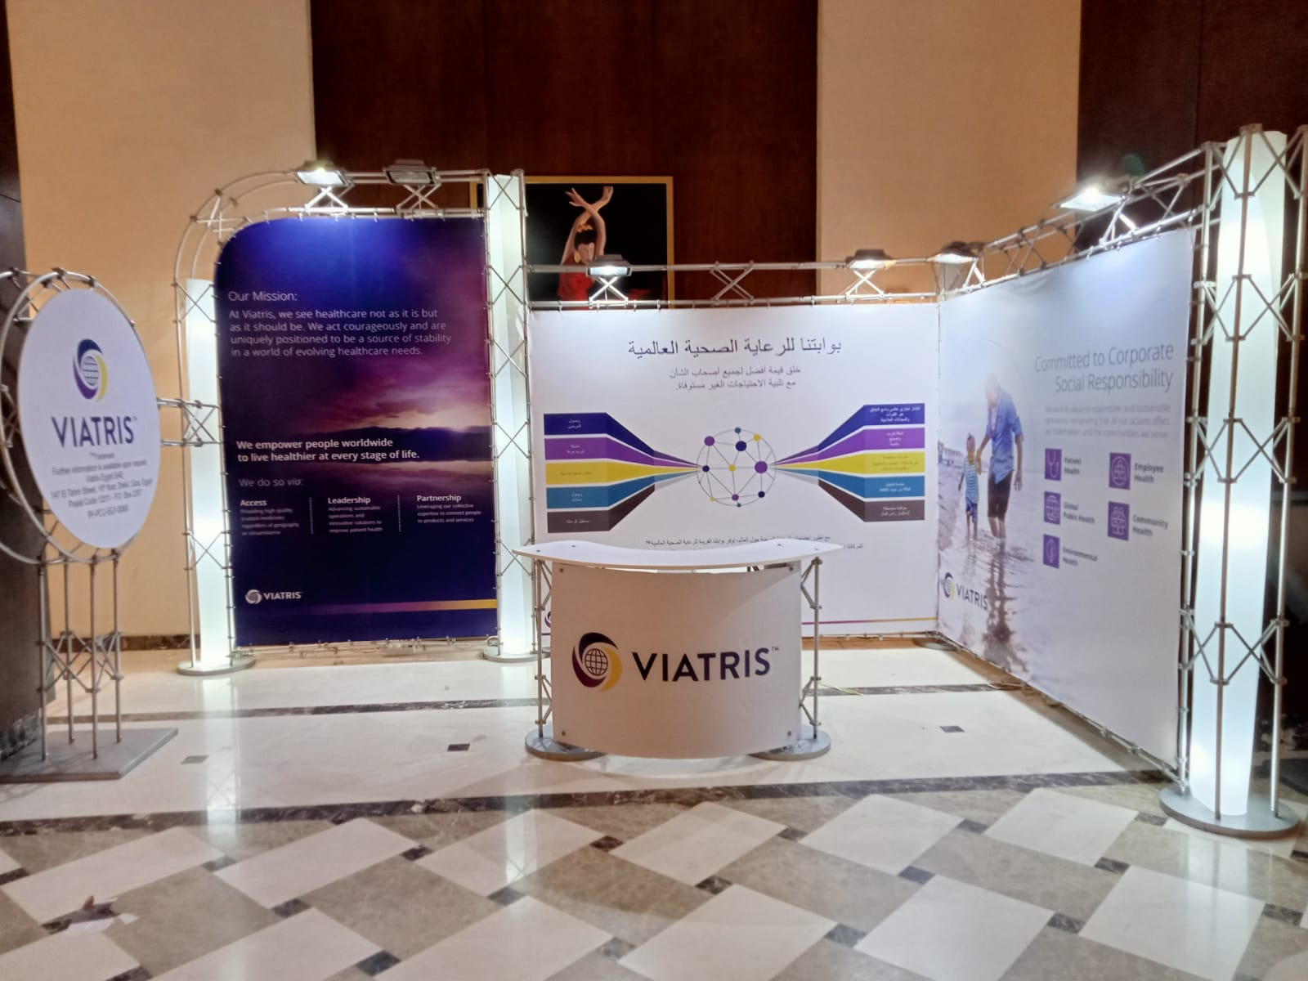

Slide 18
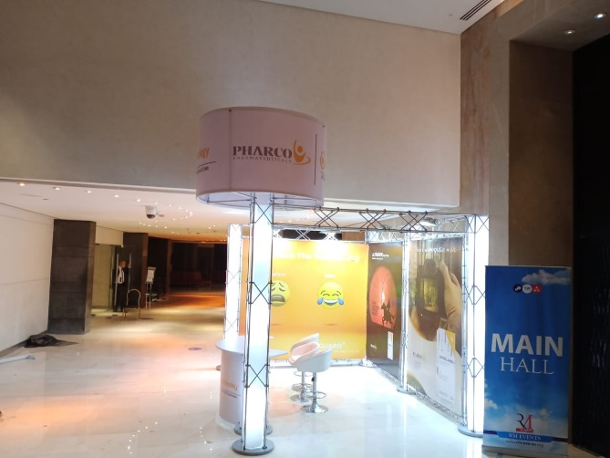
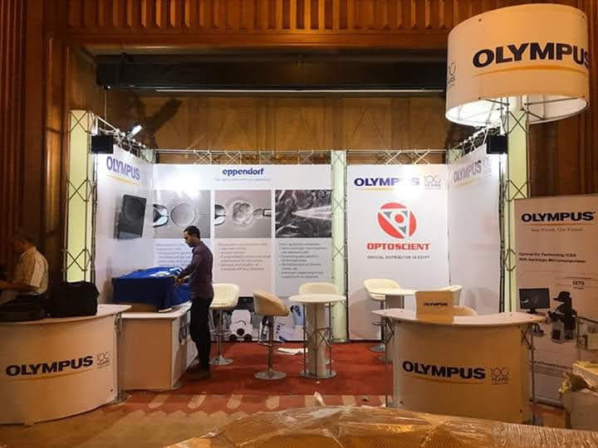
Extra Tower Code (I)
Specs:
SIZE: 85 H x 420 w
Price :
Regular: 1500 LE
Moving: 2000 LE

Slide 19
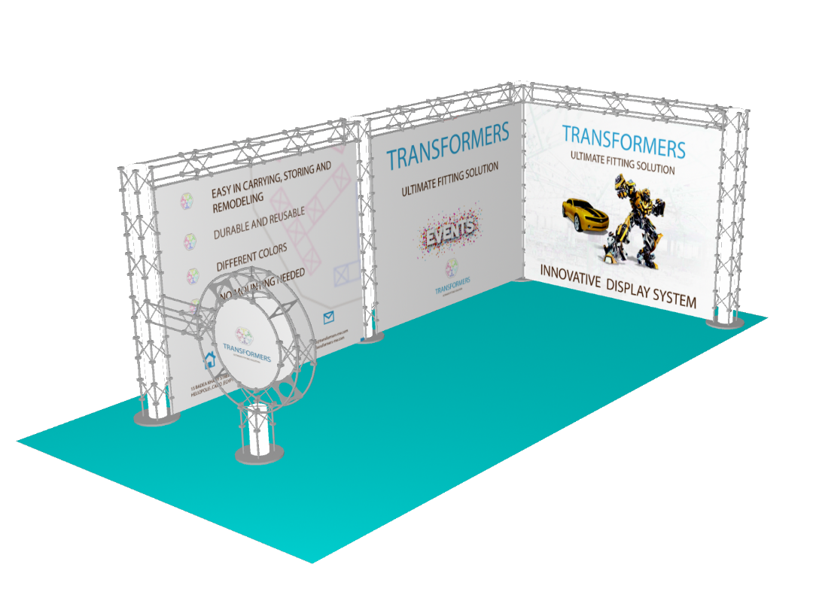
Wooden Ring Code (J)
Specs:
1- wooden ring with double print
2-DIA:125 CM
PRICE: 1000 LE

Slide 20
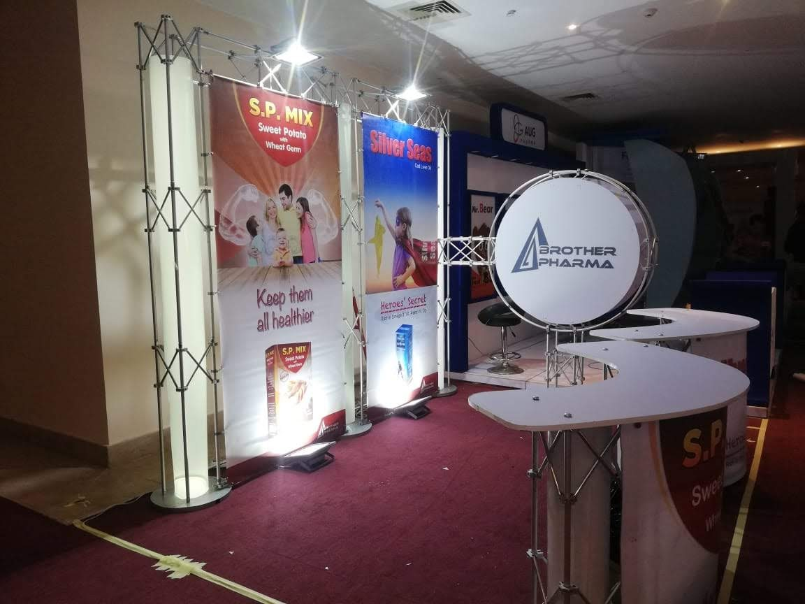
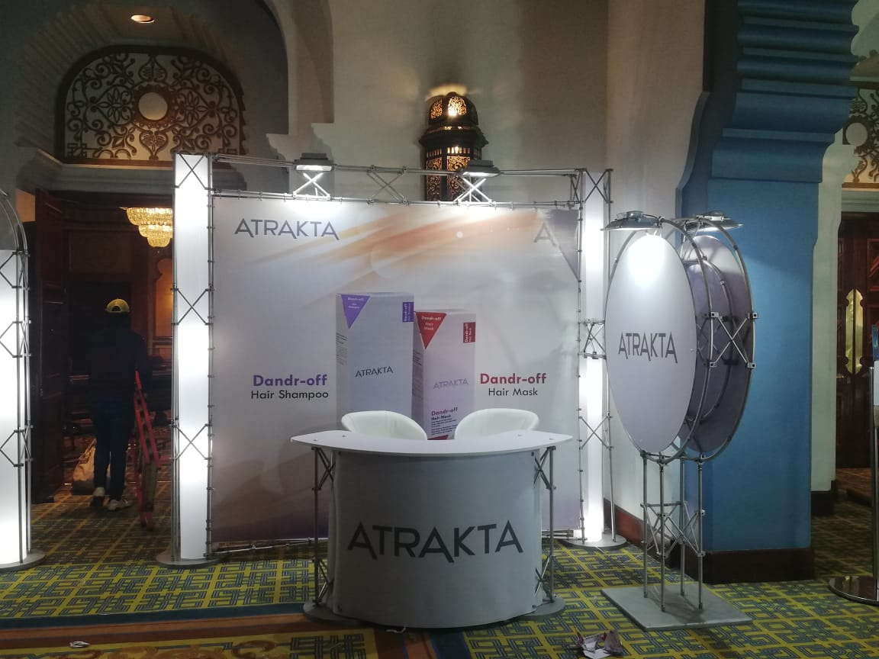

Slide 21
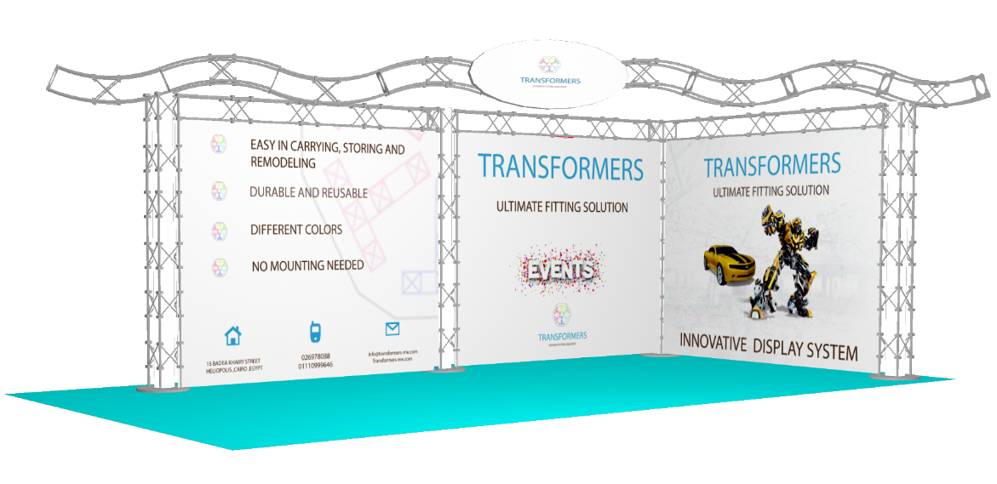
China Gate Code (K)
Specs:
PRICE : 200 LE\M

Slide 22
Wooden Sign code (L)
Specs:
Specs: 70X30 CM\ vinyl print
PRICE : 500 LE

Slide 23
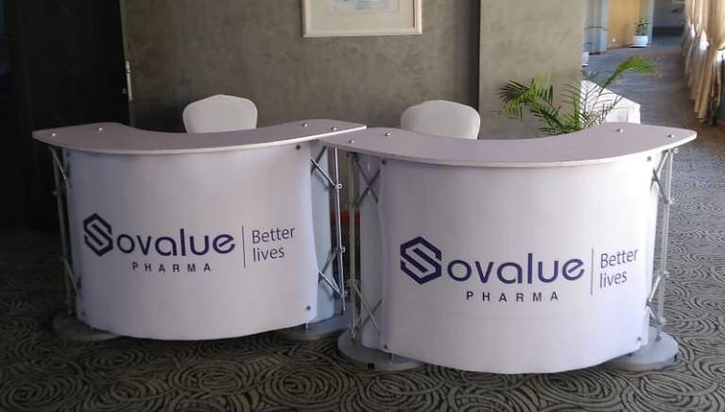
Podium code (M)
Specs:
Single print with Sign and lighting
Price: 500 LE Size:90X130

Slide 24
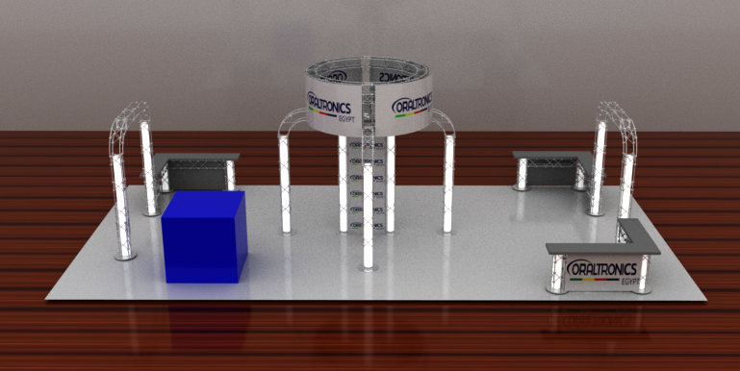
Octopus Booth Code (N)
WEDTH | DEPTH | Price
3 M | 3 M | 5500 LE
Specs:
Print and Lighting

Slide 25
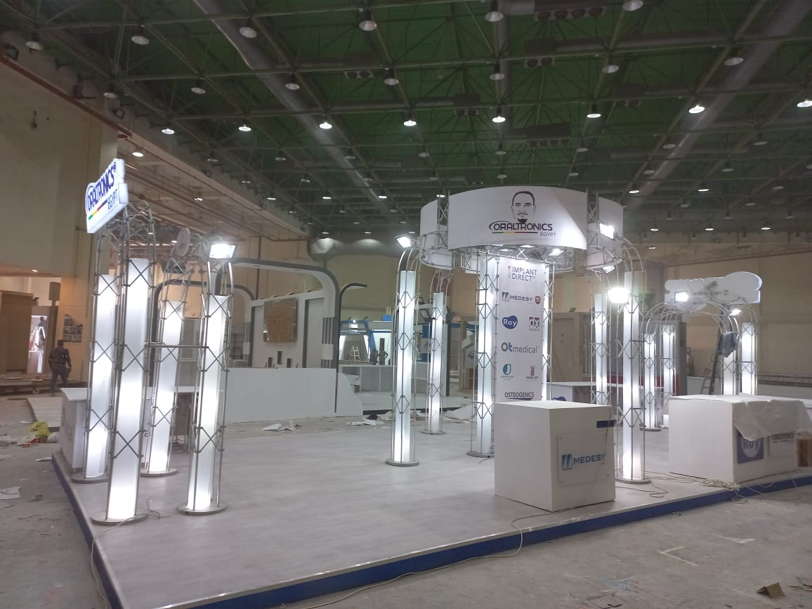
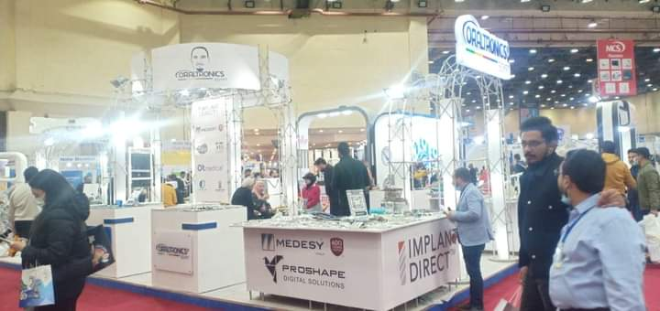

Slide 26
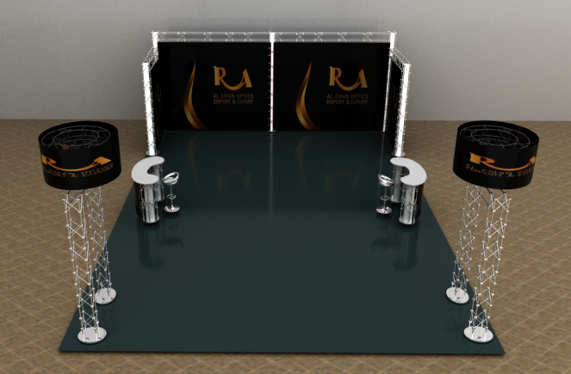
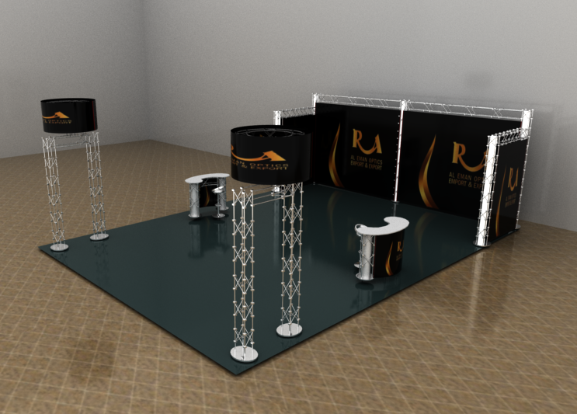
Free space booth code (O)

Slide 27
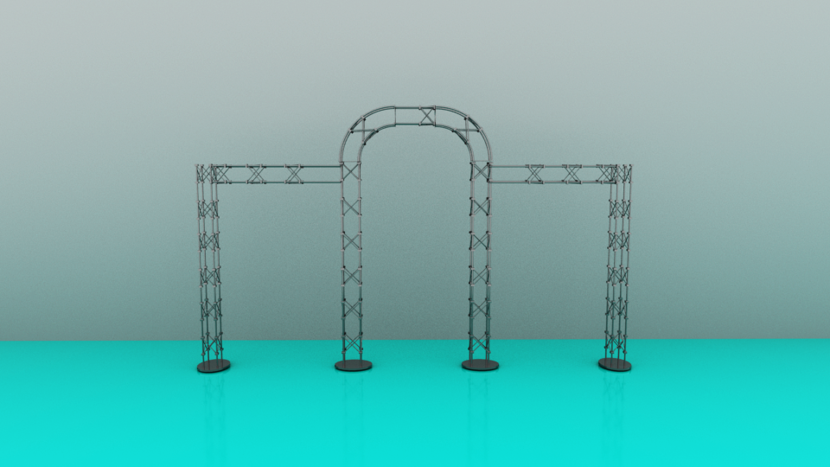
Gate Code (O)
Price: 200 LE/M2

Slide 28
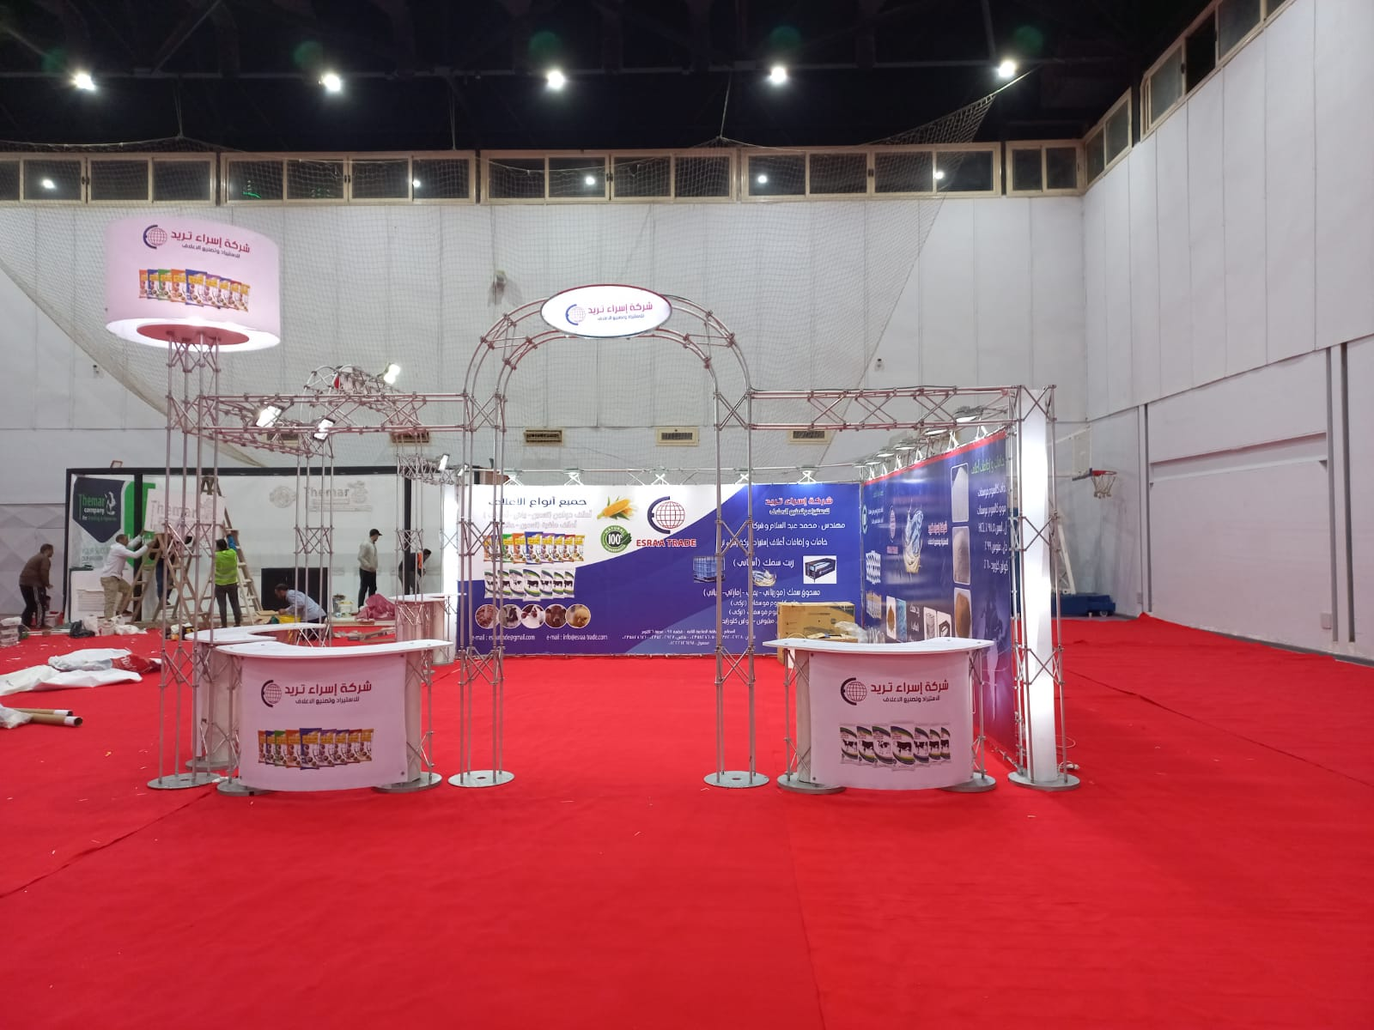
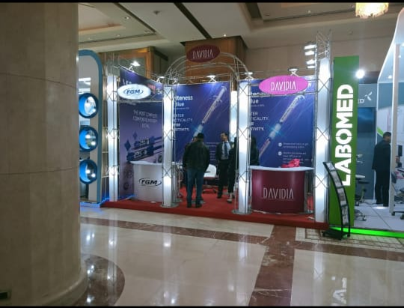

Slide 29
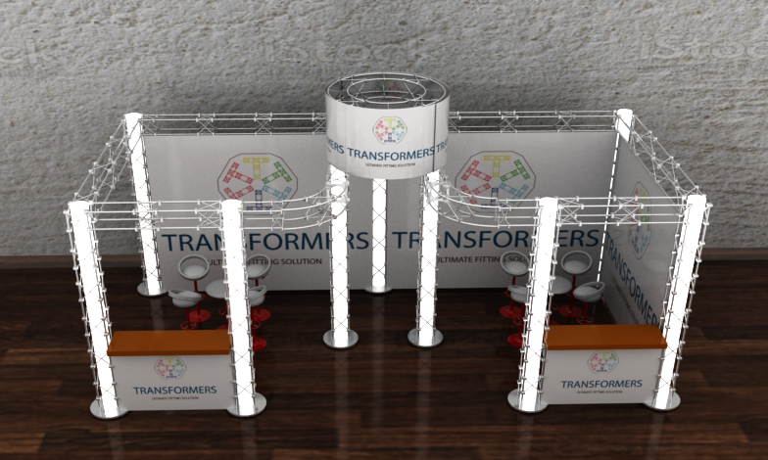
U Shape Luxury booth with tower Code (P)
WEDTH | DEPTH | Price
6 M | 3 M | 12000 LE
6 M | 4 M | 15000 LE
6 M | 5 M | 20000 LE
Specs:
1- U SHAPE BOOTH / Podium Included / Tower
2- Wooden Sign(70X30 CM\ vinyl print)

Slide 30
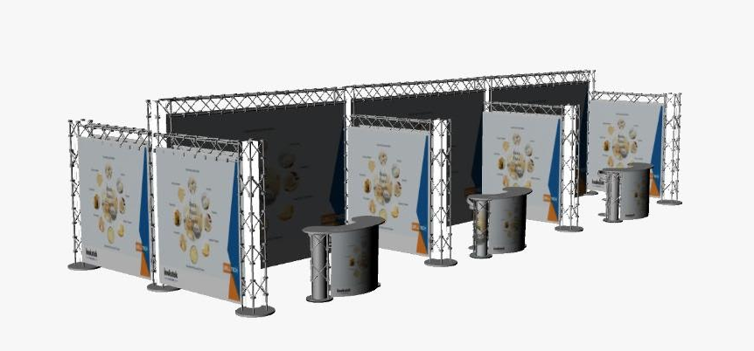
Pavilion code (Q)
WEDTH | DEPTH | Price / Unit
3 M | 3 M | 3000 LE
4 M | 3 M | 4000 LE
Specs:
1- U SHAPE BOOTH / Podium Included
2- 3 Spotlights for every 9 M2
Extra Spotlight (75 LE)

Slide 31
